Slide 1
Dynamic Trust Scoring for Secure IoT Networks
Team: Vision Vortex
Manasa K B, Nandini, Chandana A J, Indu G

Slide 2
Problem Statement
IoT devices are widely used in industries (healthcare, manufacturing, smart systems)
These devices have limited security and monitoring
Existing systems: Generate high false alerts
Do not explain risks clearly
Major Issue: Cannot detect behavioral drift (slow changes in device behavior)

Slide 3
Objective
Build a system to monitor IoT device behavior continuously
Detect:
Anomalies
Behavioral drift
Assign a dynamic trust score (0–100)
Provide clear explanations for risk

Slide 4
Proposed Solution
Our system:
Uses network telemetry (no device installation needed)
Learns normal behavior of devices
Detects:
Sudden attacks
Gradual drift
Generates:
Trust Score
Alerts with explanation

Slide 5
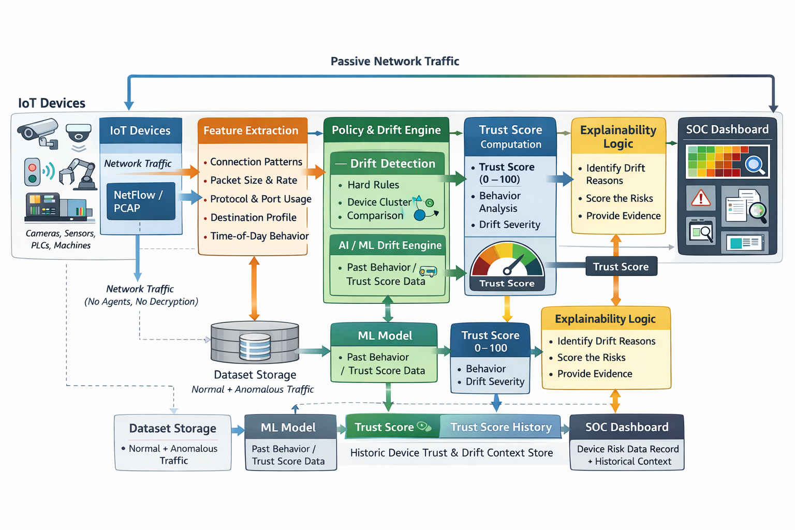
System Architecture

Slide 6
Workflow
Collect network data
Learn normal device behavior (baseline)
Monitor real-time activity
Detect:
Behavioral changes
Policy violations
Update trust score dynamically
Generate alerts with explanation

Slide 7
Key Features
Dynamic Trust Score (0–100)
Detects both sudden & gradual attacks
Low false positives
Explainable results
Agent-less (no installation required)
Works with real IoT environments

Slide 8
Demo & Conclusion
Demo Includes:
Input dataset
Model execution
Trust score changes
Drift detection alerts
Conclusion:
Provides continuous IoT monitoring
Detects threats early
Helps in better security decisions
Future scope:
Real-time deployment
Integration with IoT dashboards

